Slide 1


Deep Unsupervised Learning using Nonequilibrium Thermodynamics
CIDA Lab.
Presentation: Baekryun Seong
2024.10.08

Slide 2
Preliminary
Annealed Importance Sampling
Fokker-Planck Equation
Kolmogorov Forward and Backward Equation
Deep Unsupervised Learning using Nonequilibrium Thermodynamics
Denoising Diffusion Probabilistic Models
Table of Contents

Slide 3
Intro: Diffusion Models
“In machine learning, diffusion models, also known as diffusion probabilistic models or score-based generative models, are a class of latent variable generative models.
(… )
Diffusion-based image generators have seen widespread commercial interest, such as Stable Diffusion and DALL-E. These models typically combine diffusion models with other models, such as text-encoders and cross-attention modules to allow text-conditioned generation.
Other than computer vision, diffusion models have also found applications in natural language processing such as text generation and summarization, sound generation, and reinforcement learning.”

Slide 4
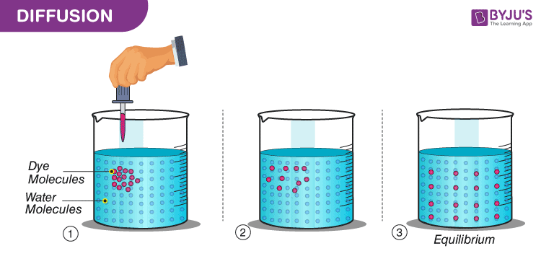
Preliminary
Notes:
확산이 이렇기는 한데, 실제로 들여다보면 사실 그렇게 물리적인 내용은 없음. 확산은 가우시안 분포와 확률론으로부터 직접적으로 정의될 수 있음.

Slide 5
Theoretical Bounds
Diffusion models have three foundation theories:
Annealed importance sampling (AIS) (Neal, 2001)
Fokker-Planck Equation
Kolmogorov forward and backward equation

Slide 6
Theoretical Bounds
Diffusion models have three foundation theories:
Annealed importance sampling (AIS) (Neal, 2001)
Fokker-Planck Equation
Kolmogorov forward and backward equation

Slide 7
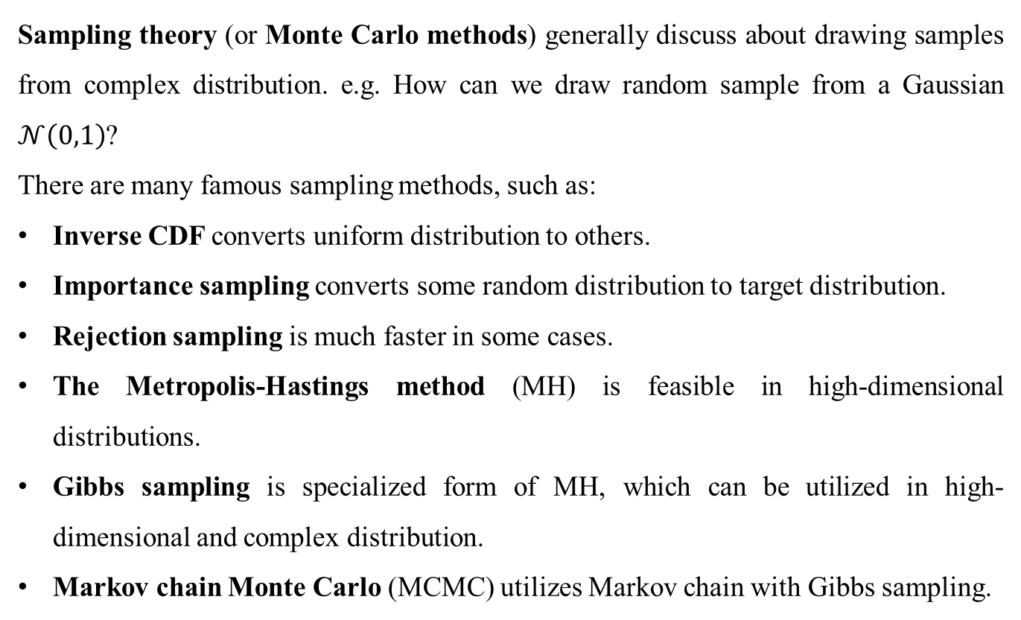
Sampling Theory
Sampling theory (or Monte Carlo methods) generally discuss about drawing samples from complex distribution. e.g. How can we draw random sample from a Gaussian $𝒩\left(0,1\right)$?
There are many famous sampling methods, such as:
Inverse CDF converts uniform distribution to others.
Importance sampling converts some random distribution to target distribution.
Rejection sampling is much faster in some cases.
The Metropolis-Hastings method (MH) is feasible in high-dimensional distributions.
Gibbs sampling is specialized form of MH, which can be utilized in high-dimensional and complex distribution.
Markov chain Monte Carlo (MCMC) utilizes Markov chain with Gibbs sampling.
Notes:
Gibbs sampling은 많이 어려운 모양인지, 조건부 확률을 설계하는 내용이 없음.

Slide 8
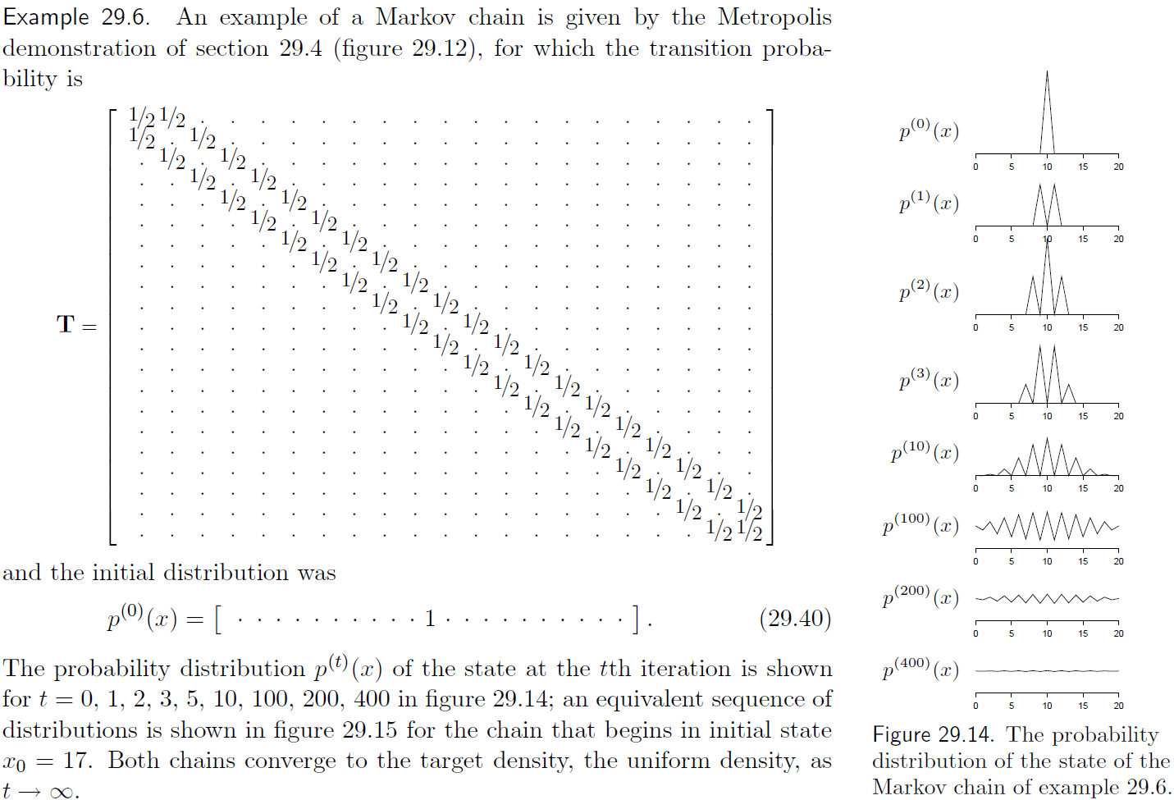
Markov Chain Monte Carlo
Notes:
Gibbs sampling은 많이 어려운 모양인지, 조건부 확률을 설계하는 내용이 없음.

Slide 9
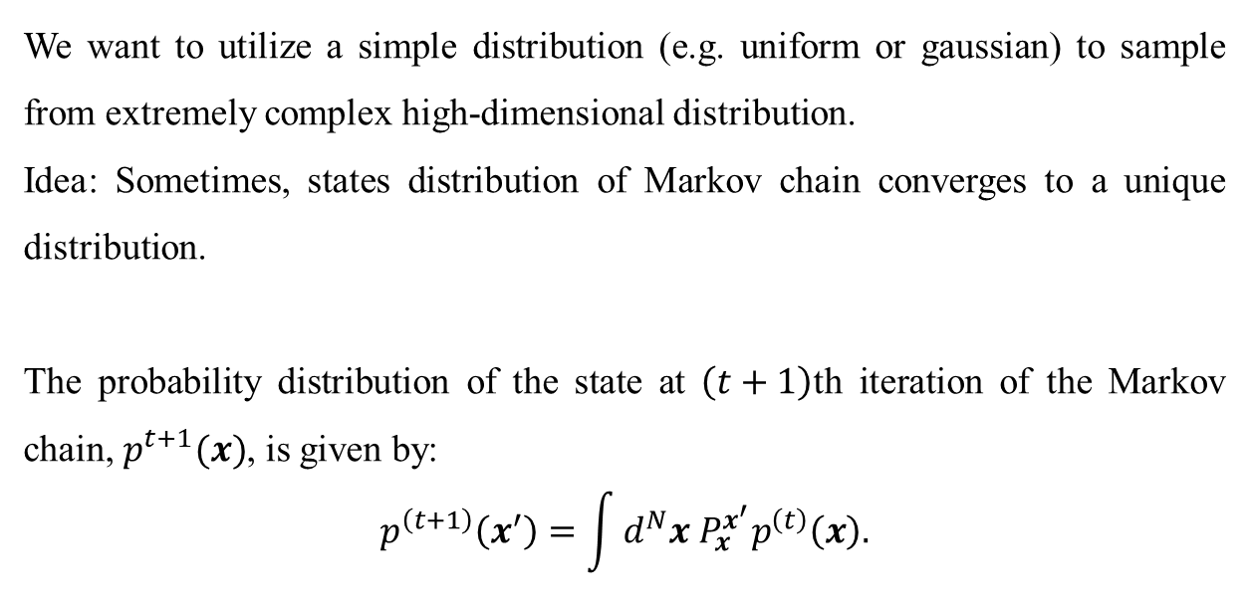
Markov Chain Monte Carlo Cont’d
We want to utilize a simple distribution (e.g. uniform or gaussian) to sample from extremely complex high-dimensional distribution.
Idea: Sometimes, states distribution of Markov chain converges to a unique distribution.
The probability distribution of the state at $\left(t+1\right)$th iteration of the Markov chain, $p^{t+1}(x)$, is given by:
$$p^{\left(t+1\right)}\left(x^{′}\right)=\int{d^{N}x P_{x}^{x^{′}}p^{\left(t\right)}\left(x\right).}$$
Notes:
Gibbs sampling은 많이 어려운 모양인지, 조건부 확률을 설계하는 내용이 없음.

Slide 10
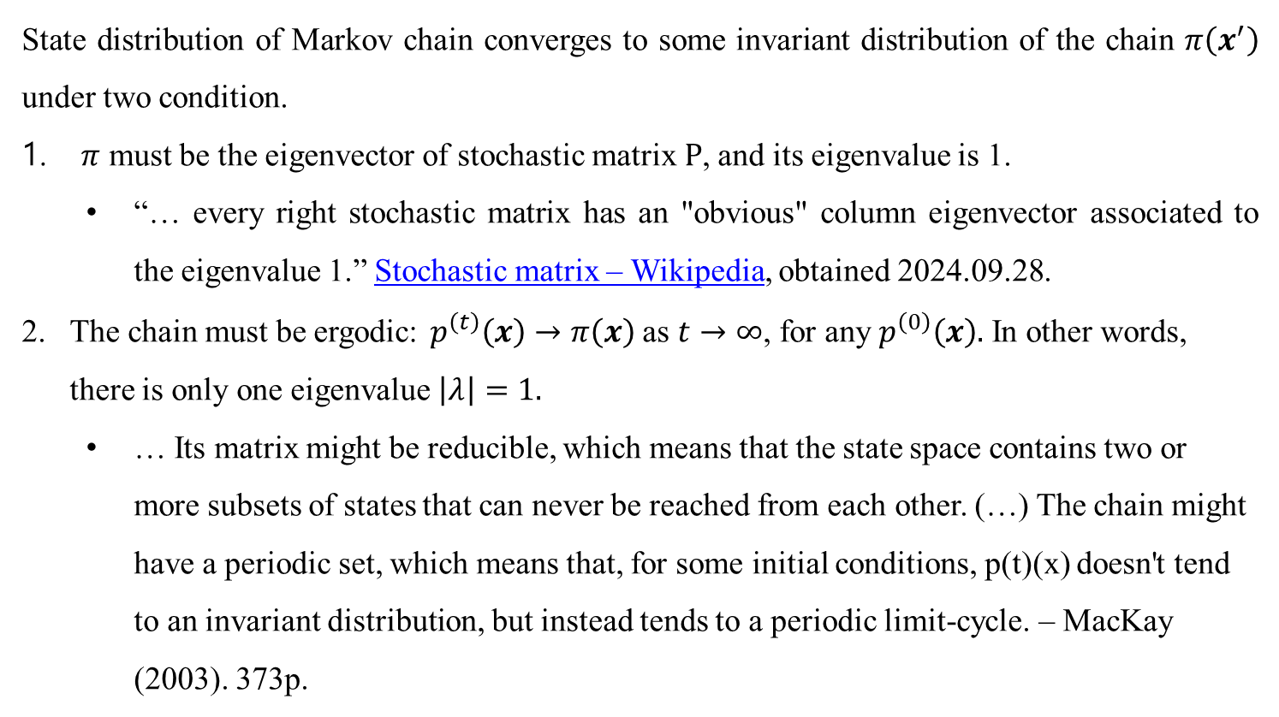
Markov Chain Monte Carlo Cont’d
State distribution of Markov chain converges to some invariant distribution of the chain $π\left(x^{′}\right)$ under two condition.
$π$ must be the eigenvector of stochastic matrix $P$, and its eigenvalue is 1.
“… every right stochastic matrix has an "obvious" column eigenvector associated to the eigenvalue 1.” Stochastic matrix – Wikipedia, obtained 2024.09.28.
The chain must be ergodic: $p^{\left(t\right)}\left(x\right)→π\left(x\right)$ as $t→∞$, for any $p^{\left(0\right)}\left(x\right).$ In other words, there is only one eigenvalue $\left|λ\right|=1.$
… Its matrix might be reducible, which means that the state space contains two or more subsets of states that can never be reached from each other. (…) The chain might have a periodic set, which means that, for some initial conditions, p(t)(x) doesn't tend to an invariant distribution, but instead tends to a periodic limit-cycle. – MacKay (2003). 373p.
Notes:
Gibbs sampling은 많이 어려운 모양인지, 조건부 확률을 설계하는 내용이 없음.

Slide 11
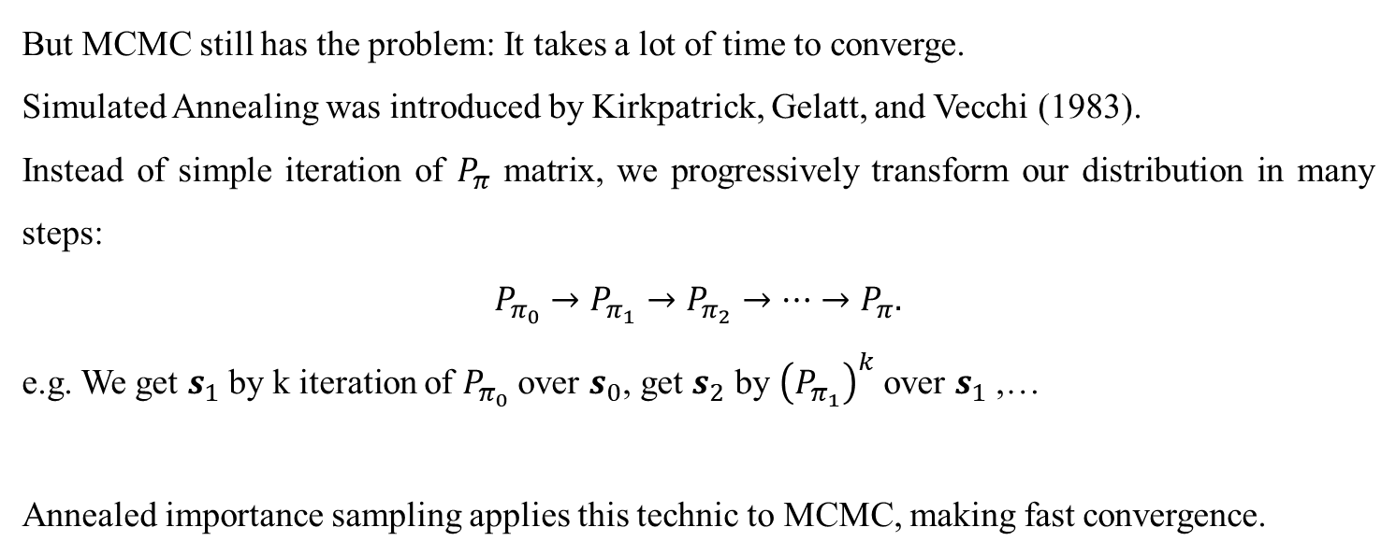
Annealed Importance Sampling
But MCMC still has the problem: It takes a lot of time to converge.
Simulated Annealing was introduced by Kirkpatrick, Gelatt, and Vecchi (1983).
Instead of simple iteration of $P_{π}$ matrix, we progressively transform our distribution in many steps:
$$P_{π_{0}}→P_{π_{1}}→P_{π_{2}}→⋯→P_{π}.$$
e.g. We get $s_{1}$ by k iteration of $P_{π_{0}}$ over $s_{0}$, get $s_{2}$ by ${\left(P_{π_{1}}\right)}^{k}$ over $s_{1}$ ,…
Annealed importance sampling applies this technic to MCMC, making fast convergence.
Notes:
Gibbs sampling은 많이 어려운 모양인지, 조건부 확률을 설계하는 내용이 없음.

Slide 12
Theoretical Bounds
Diffusion models have three foundation theories:
Annealed importance sampling (AIS) (Neal, 2001)
Fokker-Planck Equation
Kolmogorov forward and backward equation

Slide 13
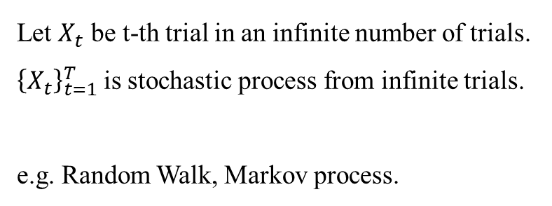
Stochastic Process
Let $X_{t}$ be t-th trial in an infinite number of trials.
${\left\{X_{t}\right\}}_{t=1}^{T}$is stochastic process from infinite trials.
e.g. Random Walk, Markov process.

Slide 14

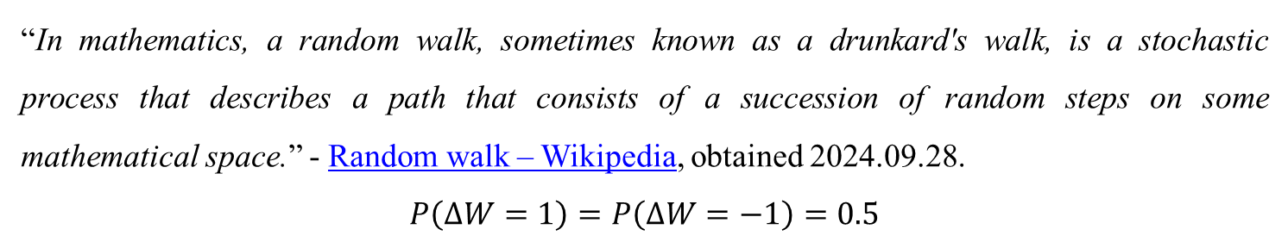
Random Walk
“In mathematics, a random walk, sometimes known as a drunkard's walk, is a stochastic process that describes a path that consists of a succession of random steps on some mathematical space.” - Random walk – Wikipedia, obtained 2024.09.28.
$$P\left(ΔW=1\right)=P\left(ΔW=−1\right)=0.5$$

Slide 15
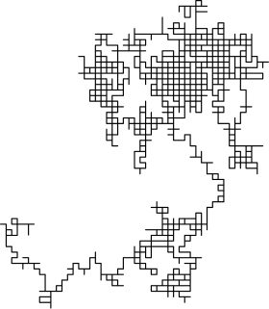
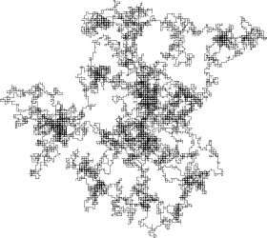
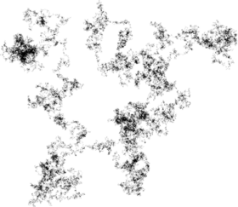
Random Walk Cont’d
But it is in descrete space. Let $ΔZ$ be continuous.

Slide 16
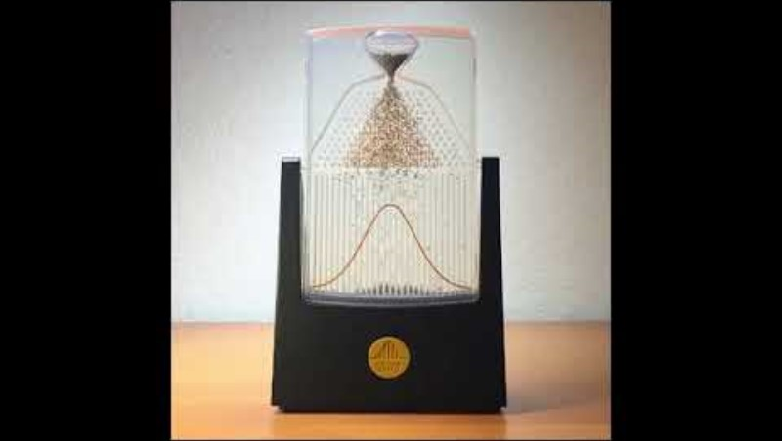
Wiener Process
At large N, binomial distributed random walk becomes normal distribution.

Slide 17
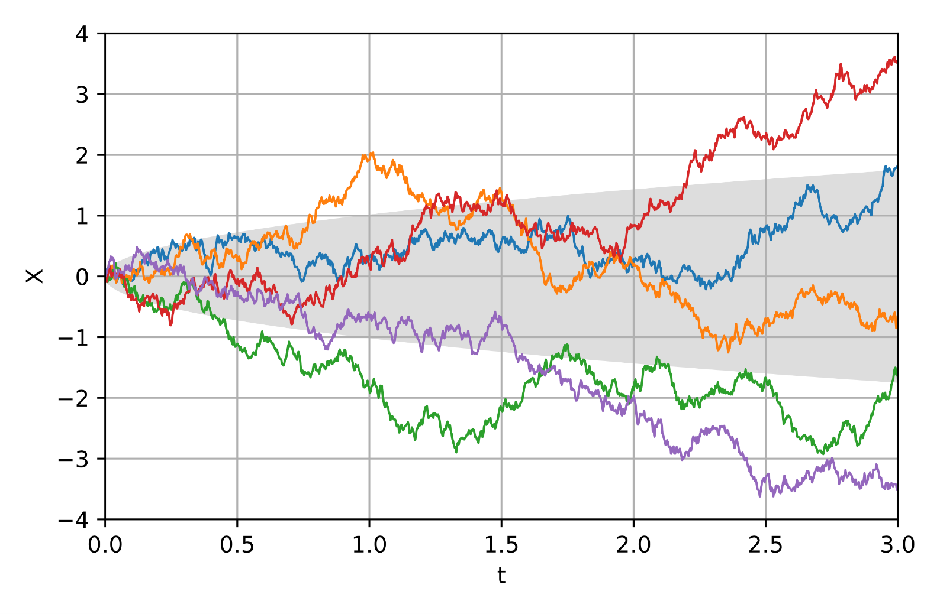
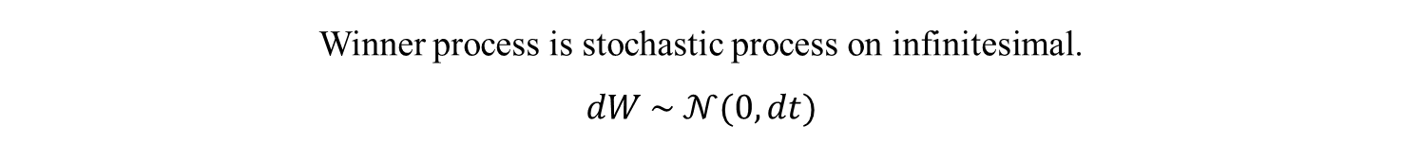
Wiener Process Cont’d
Winner process is stochastic process on infinitesimal.
$$dW \sim 𝒩(0, dt)$$
Notes:
분산이 dt일때 무한소에서의 극한이 정규분포가 된다고 합니다.

Slide 18
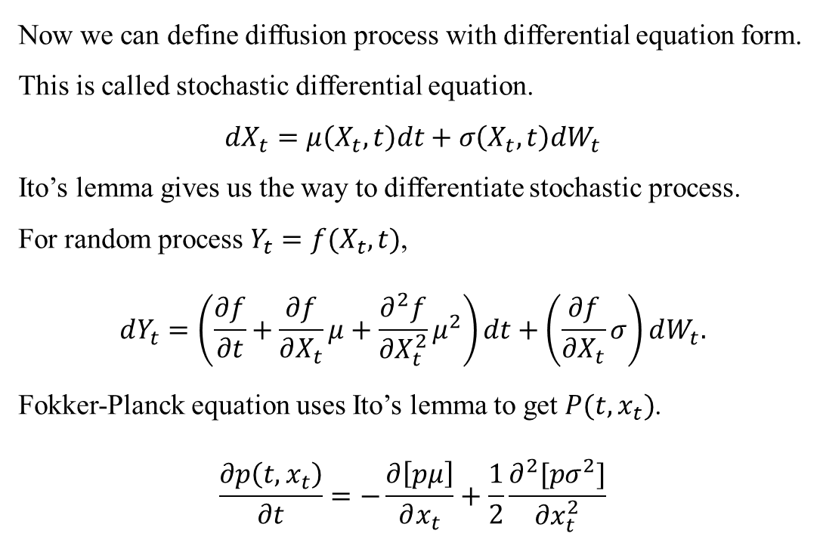
Stochastic Differential Equation
Now we can define diffusion process with differential equation form.
This is called stochastic differential equation.
$$dX_{t}=μ\left(X_{t},t\right)dt+σ\left(X_{t},t\right)dW_{t}$$
Ito’s lemma gives us the way to differentiate stochastic process.
For random process $Y_{t}=f(X_{t},t)$,
$$dY_{t}=\left(\frac{∂f}{∂t}+\frac{∂f}{∂X_{t}}μ+\frac{∂^{2}f}{∂X_{t}^{2}}μ^{2}\right)dt+\left(\frac{∂f}{∂X_{t}}σ\right)dW_{t}.$$
Fokker-Planck equation uses Ito’s lemma to get $P(t, x_{t})$.
$$\frac{∂p\left(t,x_{t}\right)}{∂t}=−\frac{∂\left[pμ\right]}{∂x_{t}}+\frac{1}{2}\frac{∂^{2}[pσ^{2}]}{∂x_{t}^{2}}$$

Slide 19
Theoretical Bounds
Diffusion models have three foundation theories:
Annealed importance sampling (AIS) (Neal, 2001)
Fokker-Planck Equation
Kolmogorov forward and backward equation

Slide 20
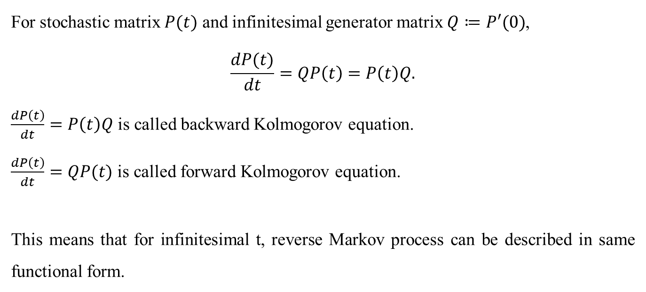
Kolmogorov Forward and Backward Equation
For stochastic matrix $P(t)$ and infinitesimal generator matrix $Q≔P′(0)$,
$$\frac{dP(t)}{dt}=QP\left(t\right)=P\left(t\right)Q.$$
$\frac{dP\left(t\right)}{dt}=P\left(t\right)Q$ is called backward Kolmogorov equation.
$\frac{dP\left(t\right)}{dt}=QP(t)$ is called forward Kolmogorov equation.
This means that for infinitesimal t, reverse Markov process can be described in same functional form.

Slide 21
Deep Unsupervised Learning using Nonequilibrium Thermodynamics
Notes:
확산이 이렇기는 한데, 실제로 들여다보면 사실 그렇게 물리적인 내용은 없음. 확산은 가우시안 분포와 확률론으로부터 직접적으로 정의될 수 있음.

Slide 22
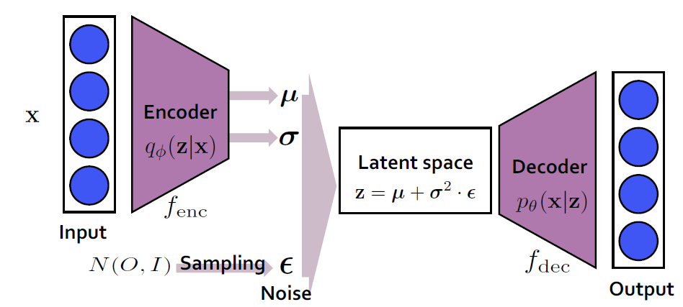
Introduction
GAN is unstable, highly dependent on hyperparameters, and not probability distribution.
VAE is stable, but generated sample is too blurry, because of ELBO maximization, and tends to utilize only a piece of latent space. (from Goodfellow, (2016))
Idea*: Multi-step VAE looks like Monte Carlo Markov chain!
Notes:
VAE가 blurry한 이유를 개인적으로 추론해보자면, 네트워크의 함수족이 너무 방대해져서 그런 것으로 보임.

Slide 23
Introduction Cont’d

Slide 24
Introduction Cont’d
Markov Process
Markov Process
Markov Process
Multi-step VAE looks like Monte Carlo Markov chain!

Slide 25
Introduction Cont’d
We can interpret diffusion models as AIS over VAE generation: generating complex input distribution by shifting prior distribution, with restricted complexity. This method constraints the function family of neural network.

Slide 26
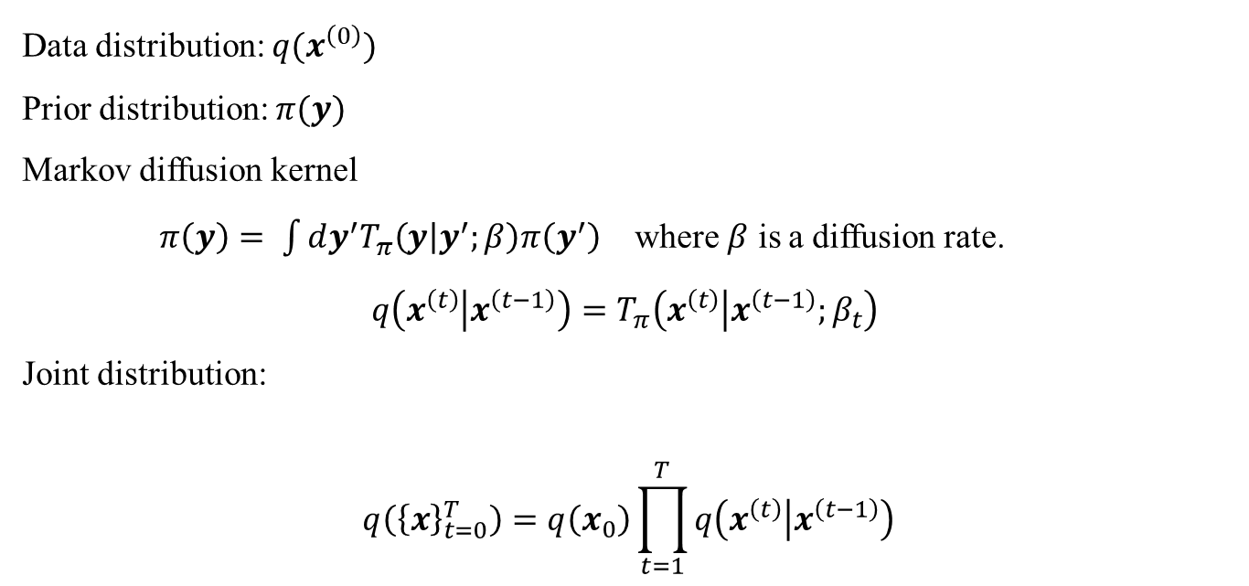
Model and Forward Trajectory
Data distribution: $q(x^{\left(0\right)})$
Prior distribution: $π(y)$
Markov diffusion kernel
$π\left(y\right)= \int{dy^{′}T_{π}\left(y | y^{′};β\right)π\left(y^{′}\right)}$ where $β$ is a diffusion rate.
$$q\left(x^{\left(t\right)} | x^{\left(t−1\right)}\right)=T_{π}\left(x^{\left(t\right)} | x^{\left(t−1\right)};β_{t}\right)$$
Joint distribution:
$$q\left({\left\{x\right\}}_{t=0}^{T}\right)=q\left(x_{0}\right)\prod_{t=1}^{T}{q\left(x^{\left(t\right)} | x^{\left(t−1\right)}\right)}$$

Slide 27
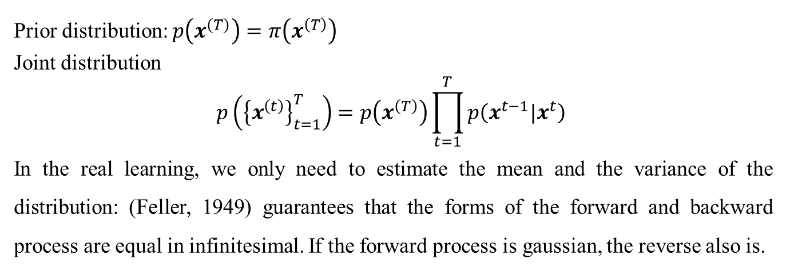
Reverse Trajectory
Prior distribution: $p\left(x^{(T)}\right)=π\left(x^{\left(T\right)}\right)$
Joint distribution
$$p\left({\left\{x^{\left(t\right)}\right\}}_{t=1}^{T}\right)=p\left(x^{\left(T\right)}\right)\prod_{t=1}^{T}{p\left(x^{t−1}|x^{t}\right) }$$
In the real learning, we only need to estimate the mean and the variance of the distribution: (Feller, 1949) guarantees that the forms of the forward and backward process are equal in infinitesimal. If the forward process is gaussian, the reverse also is.

Slide 28
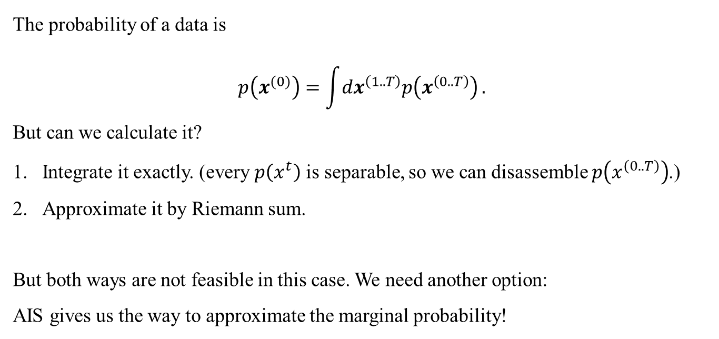
Generative Distribution
The probability of a data is
$$p\left(x^{(0)}\right)=\int{dx^{\left(1..T\right)}p\left(x^{\left(0..T\right)}\right)}.$$
But can we calculate it?
Integrate it exactly. (every $p\left(x^{t}\right)$ is separable, so we can disassemble $p\left(x^{\left(0..T\right)}\right)$.)
Approximate it by Riemann sum.
But both ways are not feasible in this case. We need another option:
AIS gives us the way to approximate the marginal probability!

Slide 29
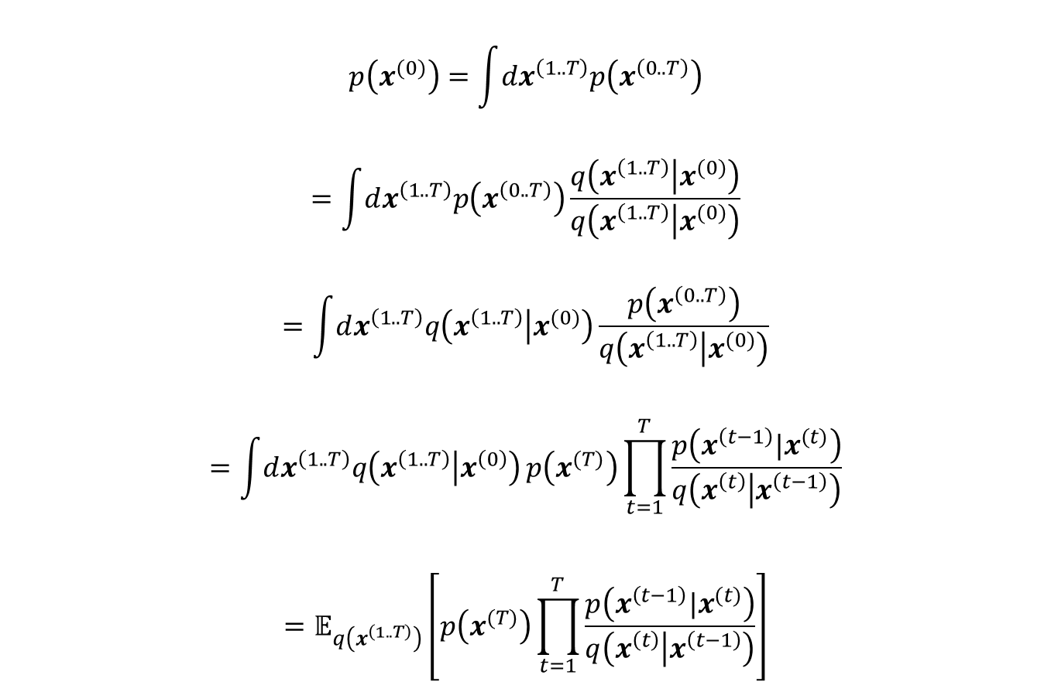
Generative Distribution Cont’d
$$p\left(x^{(0)}\right)=\int{dx^{\left(1..T\right)}p\left(x^{\left(0..T\right)}\right)}$$
$$=\int{dx^{\left(1..T\right)}p\left(x^{\left(0..T\right)}\right)}\frac{q\left(x^{\left(1..T\right)} | x^{(0)}\right)}{q\left(x^{\left(1..T\right)} | x^{(0)}\right)}$$
$$=\int{dx^{\left(1..T\right)}q\left(x^{\left(1..T\right)} | x^{(0)}\right)}\frac{p\left(x^{\left(0..T\right)}\right)}{q\left(x^{\left(1..T\right)} | x^{(0)}\right)}$$
$$=\int{dx^{\left(1..T\right)}q\left(x^{\left(1..T\right)} | x^{\left(0\right)}\right)}p\left(x^{(T)}\right)\prod_{t=1}^{T}{\frac{p\left(x^{\left(t−1\right)}|x^{(t)}\right)}{q\left(x^{\left(t\right)} | x^{\left(t−1\right)}\right)}}$$
$$=𝔼_{q\left(x^{\left(1..T\right)}\right)}\left[p\left(x^{(T)}\right)\prod_{t=1}^{T}{\frac{p\left(x^{\left(t−1\right)}|x^{(t)}\right)}{q\left(x^{\left(t\right)} | x^{\left(t−1\right)}\right)}}\right]$$

Slide 30
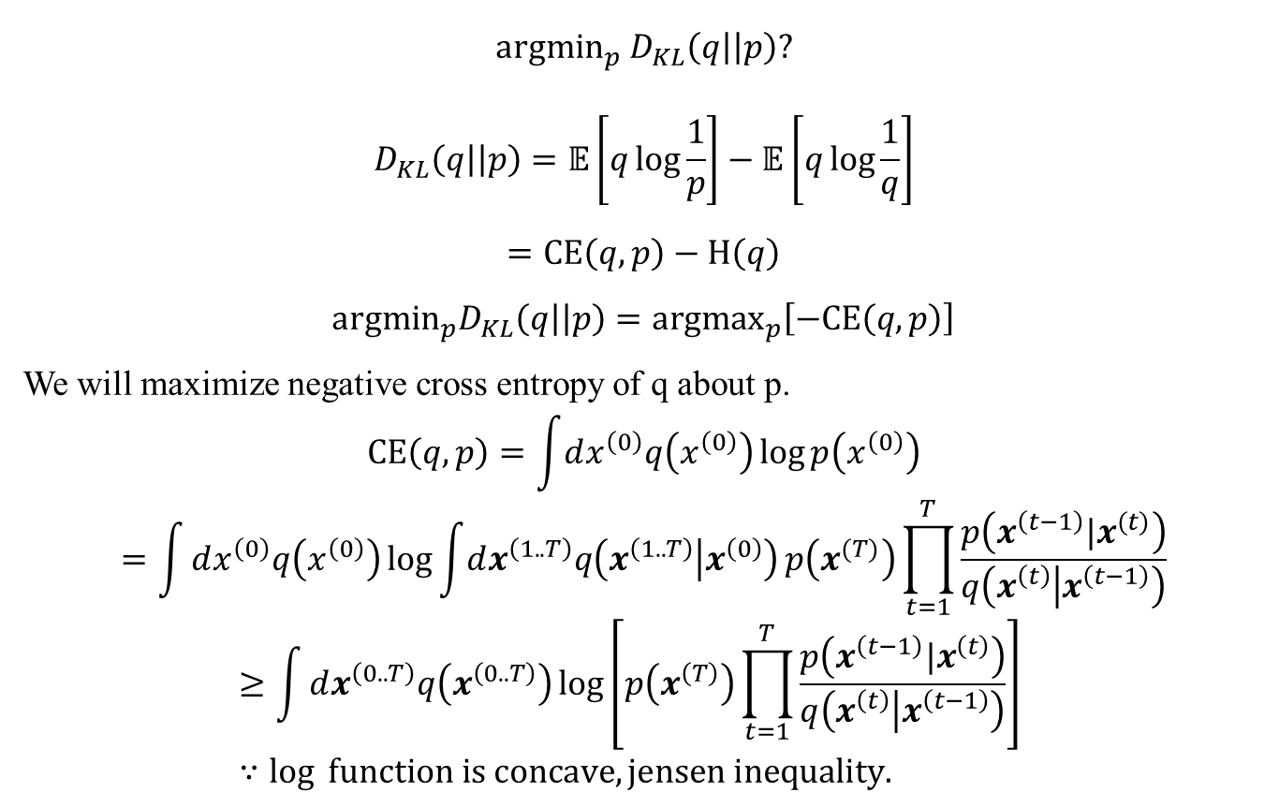
Training
$${argmin}_{p} D_{KL}\left(q\right|\left|p\right)?$$
$$D_{KL}\left(q\right|\left|p\right)=𝔼\left[q\log{\frac{1}{p}}\right]−𝔼\left[q\log{\frac{1}{q}}\right]$$
$$=CE\left(q,p\right)−H\left(q\right)$$
$$argmin_{p}D_{KL}\left(q\right|\left|p\right)={argmax}_{p}\left[−CE\left(q,p\right)\right]$$
We will maximize negative cross entropy of q about p.
$$CE\left(q,p\right)=\int{dx^{\left(0\right)}q\left(x^{\left(0\right)}\right)\log{p\left(x^{\left(0\right)}\right)}}$$
$$=\int{dx^{\left(0\right)}q\left(x^{\left(0\right)}\right)\log{\int{dx^{\left(1..T\right)}q\left(x^{\left(1..T\right)} | x^{\left(0\right)}\right)}p\left(x^{(T)}\right)\prod_{t=1}^{T}{\frac{p\left(x^{\left(t−1\right)}|x^{(t)}\right)}{q\left(x^{\left(t\right)} | x^{\left(t−1\right)}\right)}}}}$$
$$≥\int{dx^{\left(0..T\right)}q\left(x^{\left(0..T\right)}\right)\log\left[p\left(x^{\left(T\right)}\right)\prod_{t=1}^{T}{\frac{p\left(x^{\left(t−1\right)}|x^{\left(t\right)}\right)}{q\left(x^{\left(t\right)} | x^{\left(t−1\right)}\right)}}\right]} ∵\log{ function is concave, jensen inequality.}$$

Slide 31
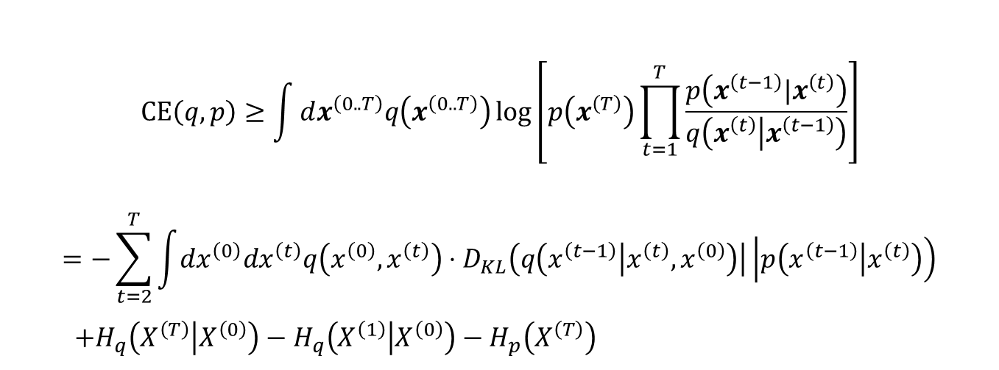
Training Cont’d
$$CE\left(q,p\right)≥\int{dx^{\left(0..T\right)}q\left(x^{\left(0..T\right)}\right)\log\left[p\left(x^{\left(T\right)}\right)\prod_{t=1}^{T}{\frac{p\left(x^{\left(t−1\right)}|x^{\left(t\right)}\right)}{q\left(x^{\left(t\right)} | x^{\left(t−1\right)}\right)}}\right]}$$
$$=−\sum_{t=2}^{T}{\int{dx^{\left(0\right)}dx^{\left(t\right)}q\left(x^{\left(0\right)},x^{\left(t\right)}\right)⋅D_{KL}\left(q\left(x^{\left(t−1\right)} | x^{\left(t\right)},x^{\left(0\right)}\right)\right|\left|p\left(x^{\left(t−1\right)} | x^{\left(t\right)}\right)\right)}} \\ +H_{q}\left(X^{\left(T\right)} | X^{\left(0\right)}\right)−H_{q}\left(X^{\left(1\right)} | X^{\left(0\right)}\right)−H_{p}\left(X^{\left(T\right)}\right)$$

Slide 32
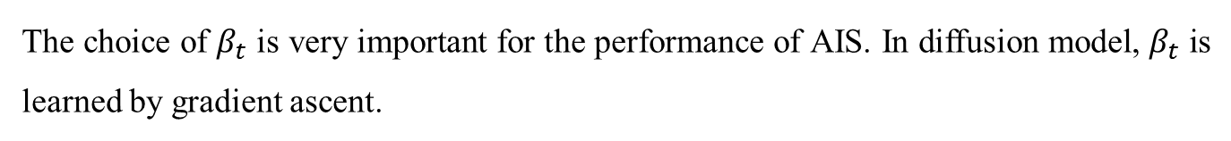
Training Cont’d
The choice of $β_{t}$ is very important for the performance of AIS. In diffusion model, $β_{t}$ is learned by gradient ascent.

Slide 33
Implementation
Papers-in-100-Lines-of-Code/Deep_Unsupervised_Learning_using_Nonequilibrium_Thermodynamics/diffusion_models.py at main · MaximeVandegar/Papers-in-100-Lines-of-Code (github.com)

Slide 34
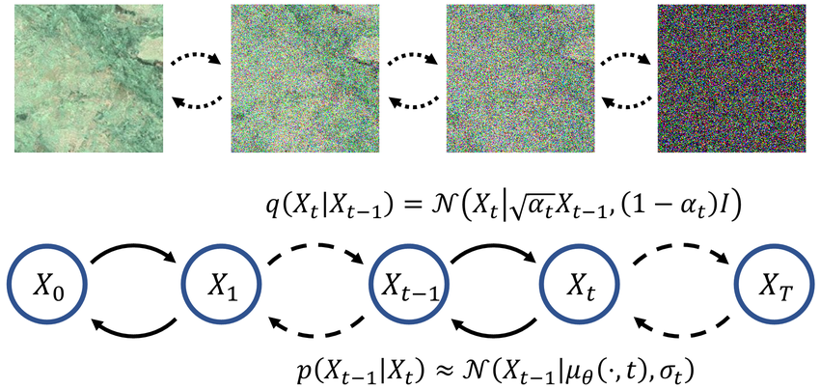
Denoising Diffusion Probabilistic Model
Notes:
확산이 이렇기는 한데, 실제로 들여다보면 사실 그렇게 물리적인 내용은 없음. 확산은 가우시안 분포와 확률론으로부터 직접적으로 정의될 수 있음.

Slide 35
Implementation
Papers-in-100-Lines-of-Code/Denoising_Diffusion_Probabilistic_Models/diffusion_models.py at main · MaximeVandegar/Papers-in-100-Lines-of-Code (github.com)

Slide 36
Discussion

